Slide 1
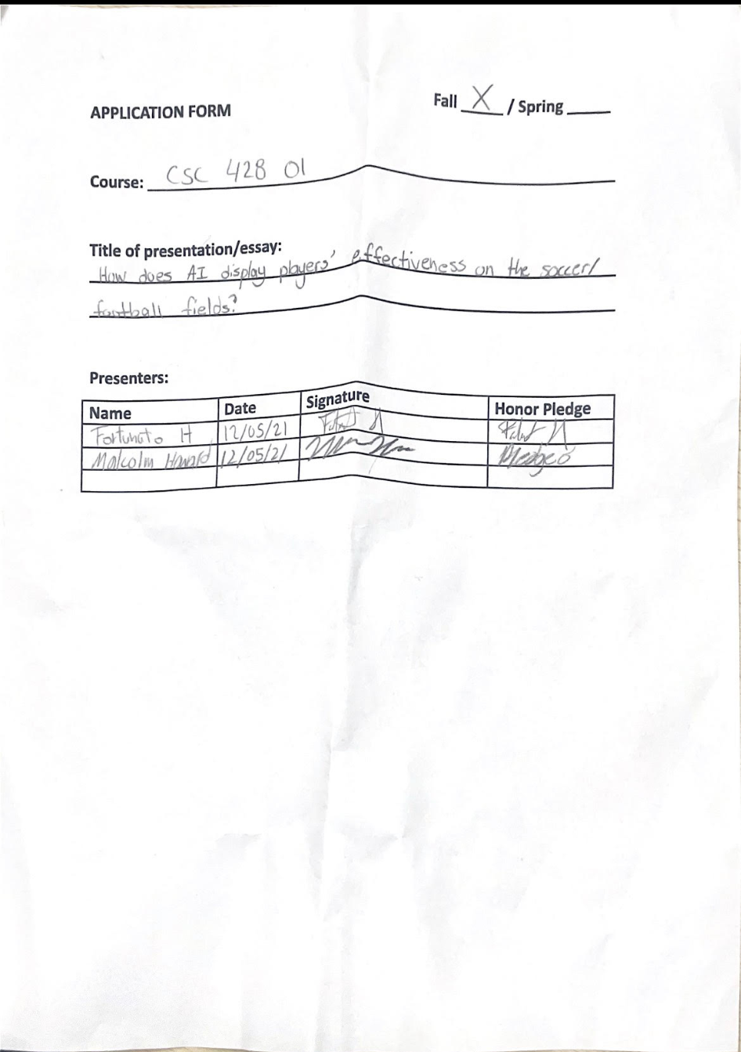

Slide 2
Sprint Review 4 (Discussion)
By Malcolm Howard & Fortunato Hernandez

Slide 3
Research Question
How does AI display players’ effectiveness on the soccer/football fields?

Slide 4
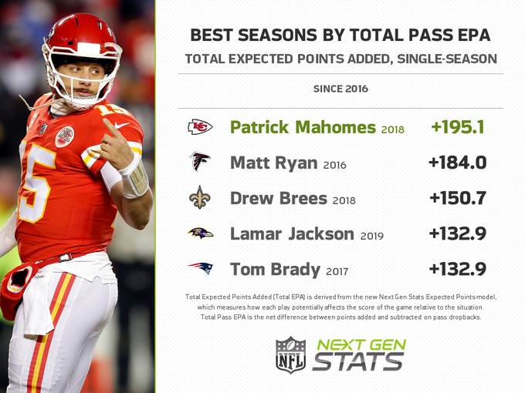
Next Gen Stats: EPA
EPA is the expected points added by a quarterback per play. This measures a players value on the field for a team. 4 of the 5 players shown have went on to win MVP for the year.

Slide 5
Next Gen Stats: Route Recognition
Route recognition is a way we can classify routes by the type it is and helps with player-tracking data.
This stat is mainly targeted for the WR position but also includes the Tight Ends and Runningbacks
There are 15 type of routes they measure:
Wideout routes(10) : Screen, flat, slant, crossing, out, in, hitch, corner, post, go
Backfield routes(5): Screen, flat, angle, out, wheel

Slide 6
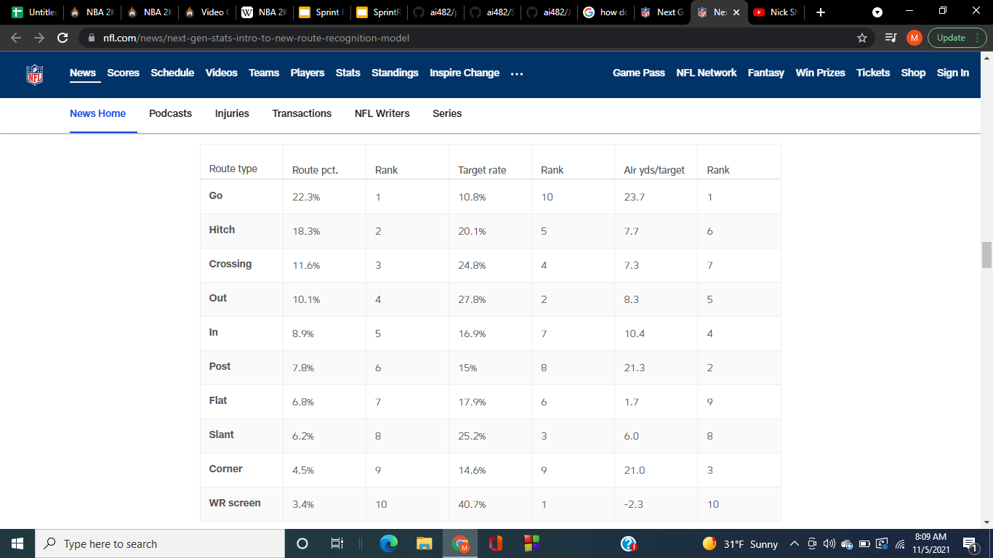
Route Recognition cont.

Slide 7

Route Recognition cont. (production)

Slide 8
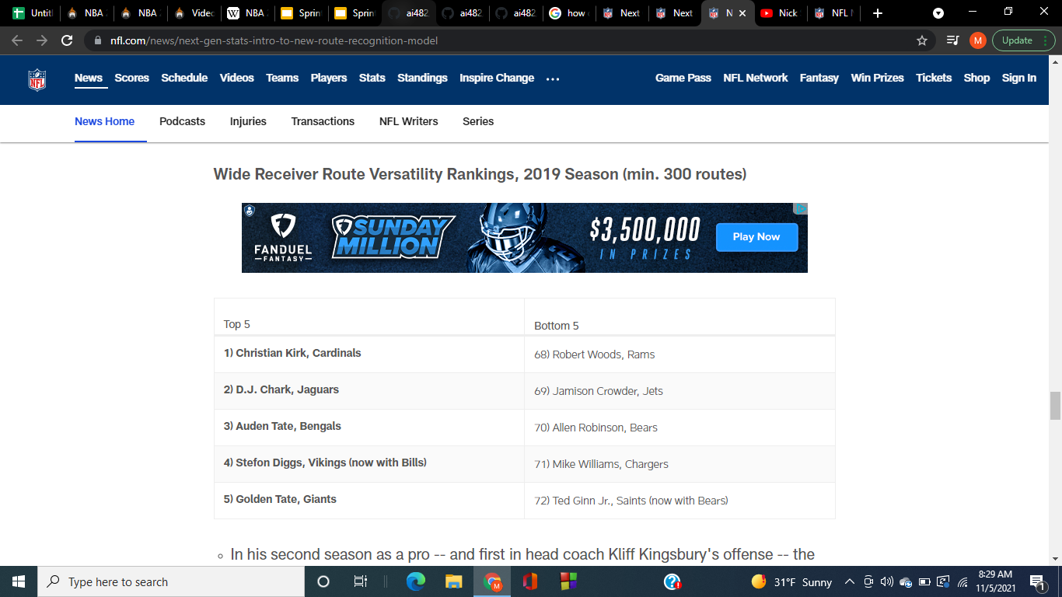
Route Recognition cont. (variation)

Slide 9
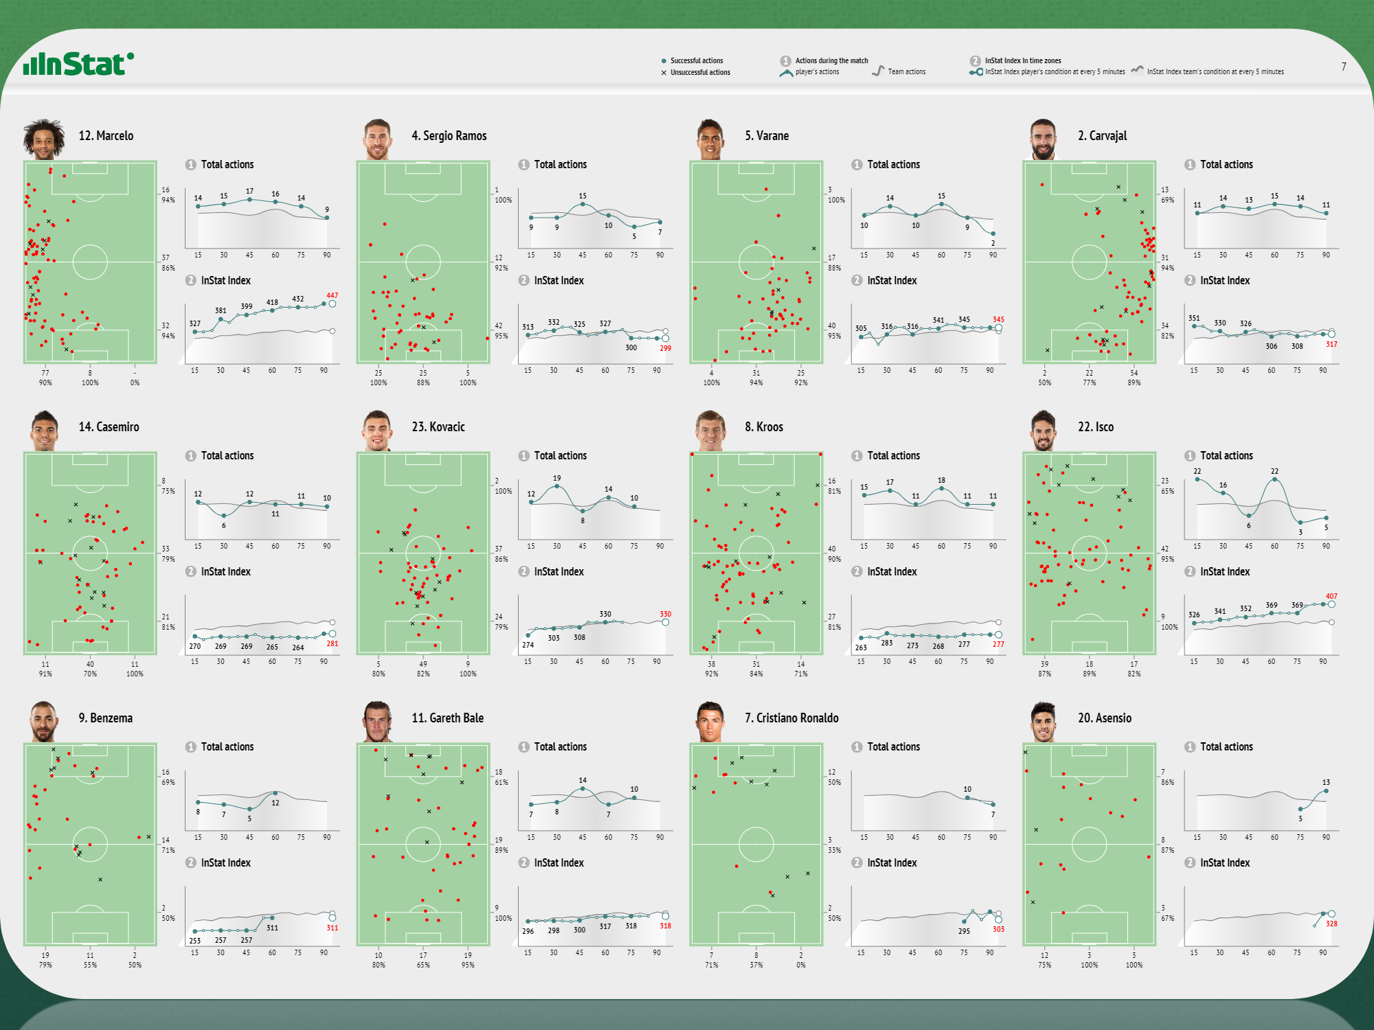
Instat
With Instat, soccer players can see how they are performing in games and practice. This data will help them to know if they are being effective on the field.

Slide 10
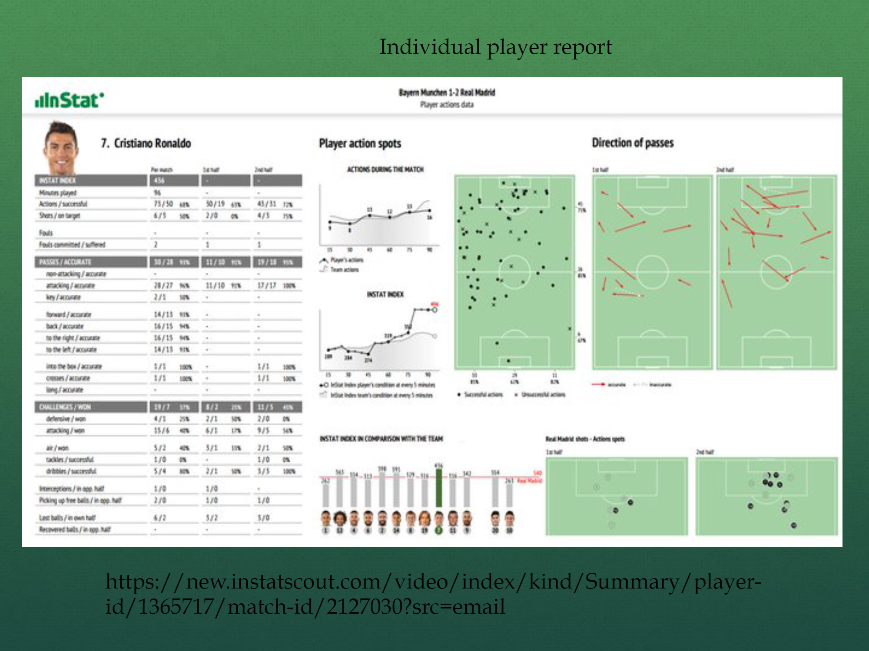

Slide 11
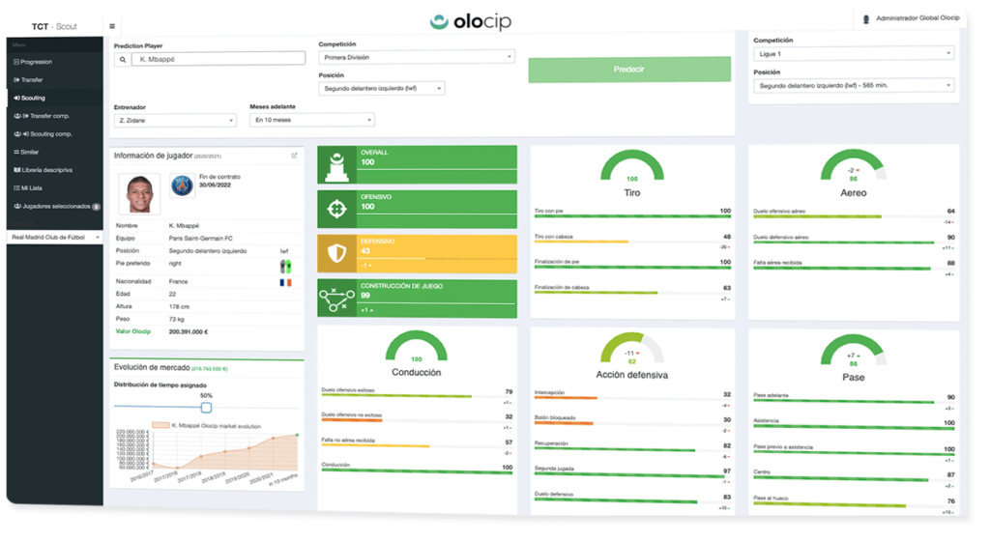
Olocip
Olocip is a predictive performance analysis platform.

Slide 12
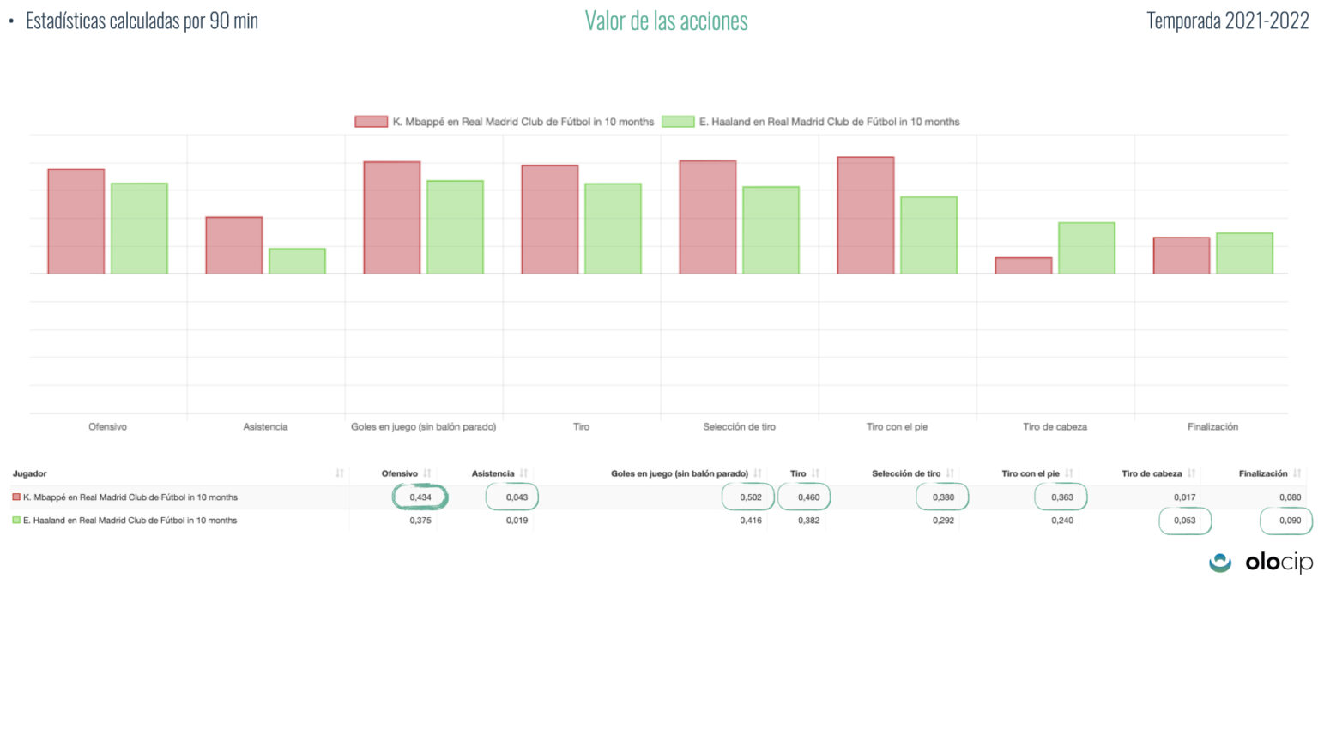

Slide 13
Analysis
Football
Soccer
Based on the data, you can see how well the players produce on the field and how effective certain things can be to elevate a team’s level of competition. This can keep players updated on how well they are doing and what things they can do to take their game to another level. This can also help coaches to see where they should put a player on the field to use them to their best ability for the team.
Based on the data that AI apps like Instat and Olocip gather, soccer coaches can see which players are more effective on the field in each of their positions. For example, for midfielders the data that coaches look for are: passes accuracy (forward), key passes, ball interceptions, challenges won, defensive and attacking positioning, distance run per game, etc. With all of these data, coaches can choose the more effective midfielder for next games.

Slide 14
Bias/Flaws
Football
Soccer
Some flaws or bias things that can come from this information is favoritism. Some of the data showed can possibly set for players that have more fame to have better looking stats to keep them relevant. There is also possible data set up to where if they want to make a player look bad or someone they dislike look bad , they can set it around to make them look like they are not producing on the field and can hurt their careers. Another flaw is that they can hurt player production.
A flaw in the use of AI in soccer is that sometimes some coaches rely too much on it. The data is there to help coaches to realize some things that they might not see at the game and practices, but not to tell them who should play. Another one is that media can use the data against players, which sometimes can bring the player’s confidence down or in some cases hurt their careers.

Slide 15
Work Cited
The Next Gen Stats Analytics Team. “Next Gen Stats: New Advanced Metrics You NEED to Know for the 2020 NFL Season.” NFL.Com, Mike Band, 19 Nov. 2020,
“Ricardo Pombo Interview.” InStat, https://instatsport.com/football/ricardo_pombo_interview.
“Instat for Players.” InStat, https://instatsport.com/football/for_players.

